Slide 1
TITLE:-The Ultimate Trifecta: Tic Tac Toe, Ping Pong, and Number Guessing Combined
INTRODUCTION:-
We have created a multiplayer game using Java and JFrame which includes three games:-
Tic-Tac-Toe
Ping-Pong
Number-Guessing

Slide 2
Tic-Tac-Toe is a simple and popular game played on a 3x3 grid. The objective of the game is to get three of your marks (either X or O) in a row, either horizontally, vertically, or diagonally. It's a two-player game, with each player taking turns placing their mark on the board. The player who gets three in a row first, wins the game.To start the game, the first player (who is usually chosen randomly) places their mark (X or O) on an empty cell on the grid. Then the second player takes their turn, placing their mark on another empty cell. The game continues like this until one of the players has three of their marks in a row, or until all of the cells on the grid are filled up.If all the cells on the grid are filled up and neither player has won, then the game ends in a tie. Tic Tac Toe is a great game for teaching strategy and critical thinking skills, and it can be enjoyed by people of all ages.
Pong-Game is a classic and addictive game that has been enjoyed by generations! In this simple yet exciting game, players control paddles to hit a ball back and forth across the screen. The goal is to prevent the ball from passing your paddle while trying to score points by getting the ball past your opponent's paddle. PongGame is a perfect choice for anyone looking for a fun and challenging way to pass the time. So, get ready to test your reflexes and improve your skills in this timeless game!

Slide 3
Number-Guessing game is a fun and challenging game that will test your ability to guess a random number between 1 and 100. The objective of the game is to correctly guess the randomly generated number within the fewest attempts possible. With each guess, you will receive feedback indicating whether your guess is too high or too low, giving you clues to help you make your next guess. So, put your thinkingcap on, sharpen your math skills, and let's see how good you are at guessing!
Requirements:-
JAVA
Java Swing
Java AWT
Java JFrame

Slide 4
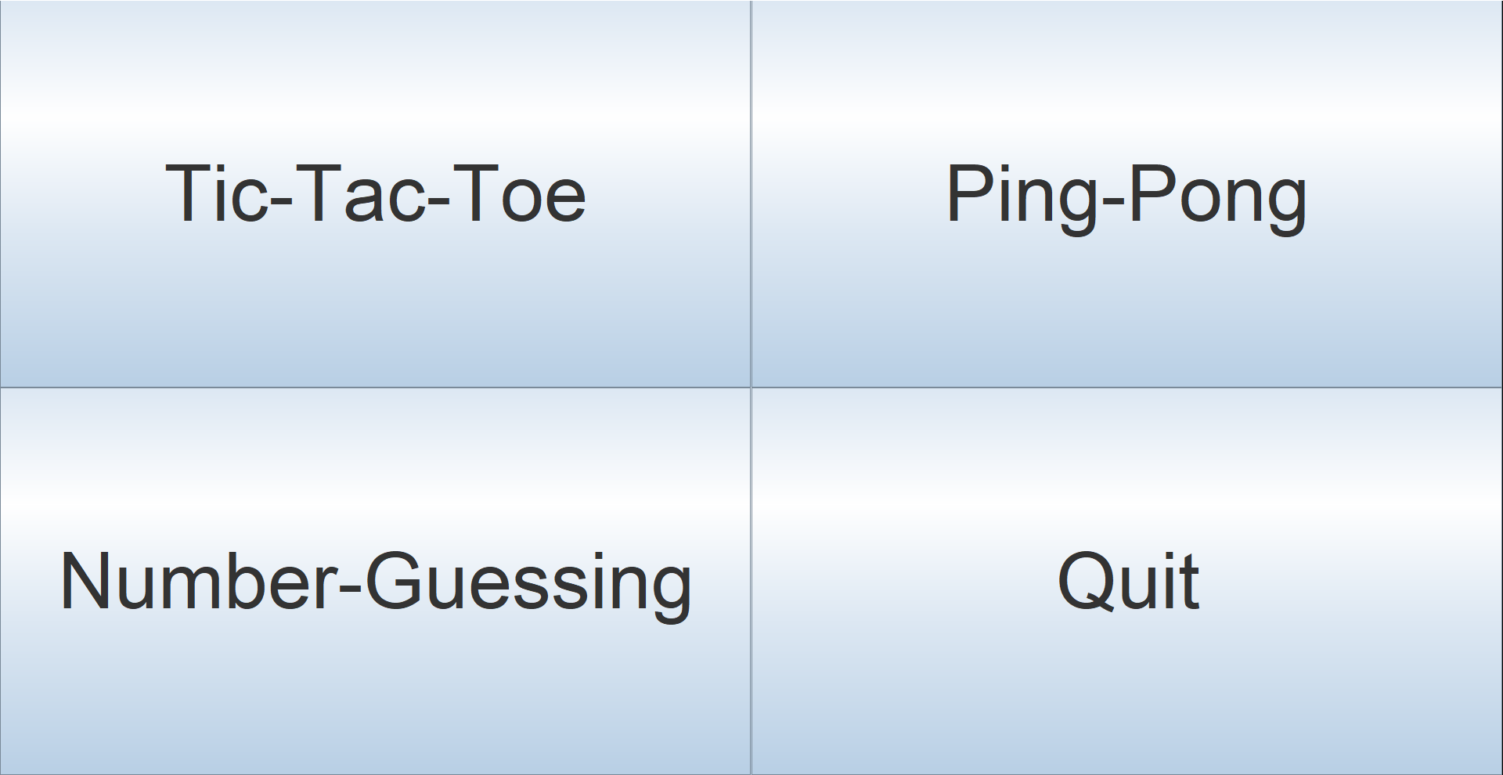
MODULE 1:Main Frame:-

Slide 5
Implementation:-
The code is a Java program that creates a graphical user interface (GUI) for a game project. The GUI has four buttons:
Tic-Tac-Toe button
Ping-Pong button
Number-Guessing button
Quit button
The code imports the necessary classes from the javax.swing and java.awt packages.
The class GameProject extends JFrame and implements the ActionListener interface.
The class GameProject has four instance variables of type JButton: ticTacToeButton, pingpong, numberguessing, and quitButton.
The constructor of GameProject creates four buttons with the specified text labels and adds an ActionListener to each of them.
The constructor also sets the font of each button and adds them to a JPanel with a 2x2 grid layout.
The constructor then adds the JPanel to the JFrame and sets various properties of the JFrame.The actionPerformed method is called when one of the buttons is clicked. Depending on which button is clicked, it creates an instance of a game class: TicTacToe, PongGame, or NumberGuessingGame.
The main method creates an instance of the GameProject class, which creates the GUI.

Slide 6
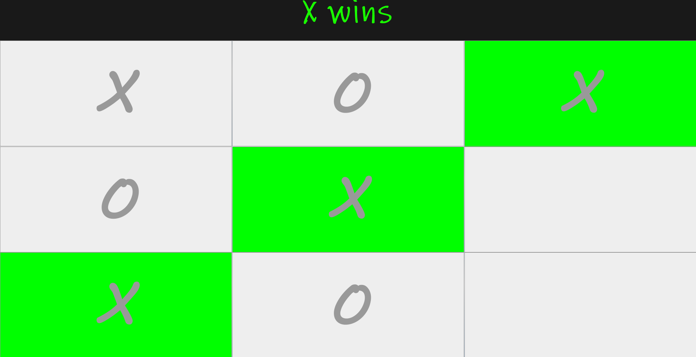
MODULE 2:Tic-Tac-Toe game:-

Slide 7
Implementation:-
The TicTacToe class implements the game logic and the user interface using Swing components.
The class extends ActionListener to handle user clicks on the buttons.
The main method creates an instance of the TicTacToe class, which initializes the user interface and starts the game.
The user interface consists of a title panel with a label that shows the game title ("Tic-Tac-Toe") and a button panel with 9 buttons arranged in a 3x3 grid.
The buttons array holds references to the button objects, which are initialized with the JButton constructor and added to the button panel with the add method.
The player1_turn boolean variable keeps track of which player's turn it is.
The firstTurn method randomly determines which player goes first.
The check method checks the current state of the game to see if either player has won or if the game has ended in a draw.
The xWins and oWins methods display a message indicating which player has won and highlight the winning cells by changing their color.
The actionPerformed method is called whenever a button is clicked. If the button is empty, the player's symbol ("X" or "O") is added to the button and the turn is switched to the other player.
The check method is called to see if the game has ended.
The main() method creates a new instance of the "TicTacToe" class.

Slide 8
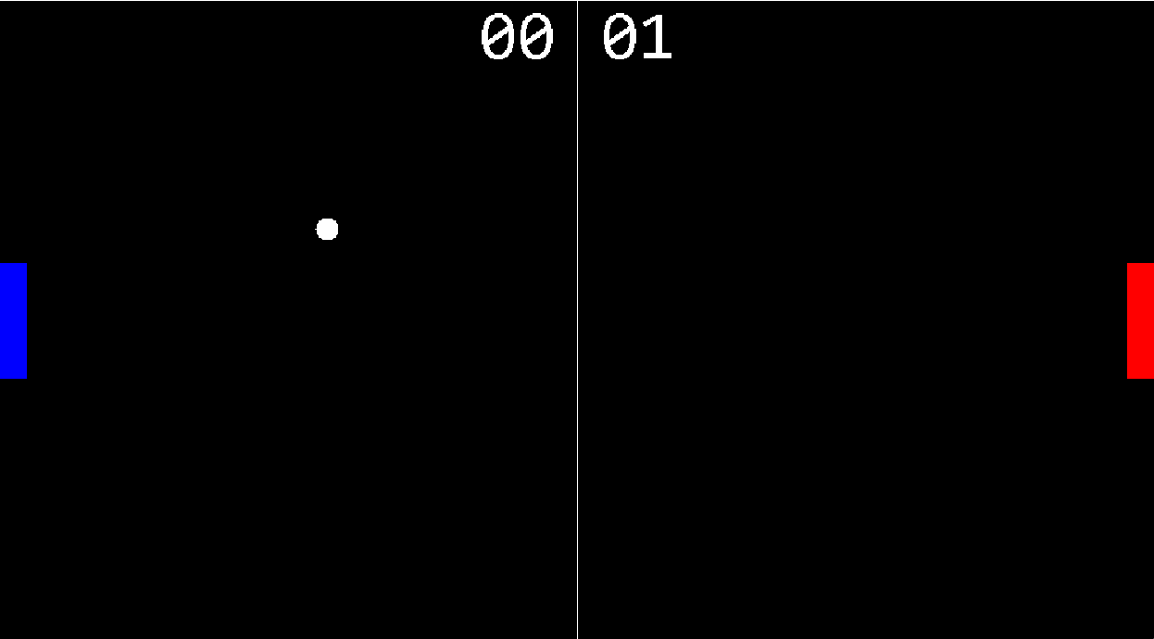
MODULE 3:Ping-Pong game:-

Slide 9
Implementation:-
GamePanel:
Extends JPanel and implements Runnable.
Handles the game logic and rendering.
Contains instance variables for game elements such as paddles, ball, and score.
Overrides paint() to render the game elements.
Overrides run() to implement the game loop.
GameFrame:
Extends Jframe
Creates and adds a GamePanel instance to the frame.
Sets various properties of the JFrame such as title, resizable, background color, and location.
Displays the frame to the user.
Ball:
Extends Rectangle
Represents the ball in the Pong game.
Contains instance variables for its position and velocity.
Has methods for updating its position and velocity.
Handles collisions with the walls and paddles.

Slide 10
Paddle:
Extends Rectangle
Represents a paddle in the Pong game.
Contains instance variables for its position, size, and velocity.
Has methods for updating its position and velocity based on user input.
Handles collisions with the walls and ball.
Score:
Represents the score in the Pong game.
Contains instance variables for the score of each player and the dimensions of the game window.
Has methods for incrementing the score of each player and rendering the score on the screen.
PongGame:
Contains the main method for running the game.
Creates and displays a GameFrame instance to the user.

Slide 11
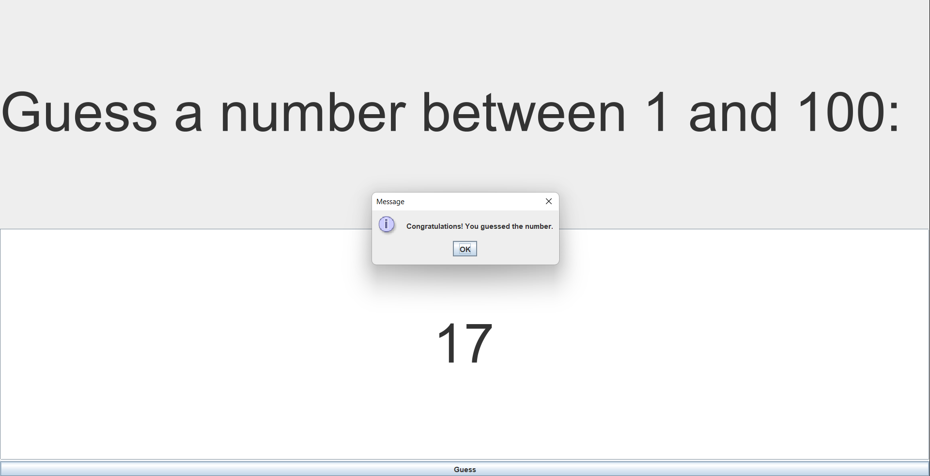
MODULE 4:Number-Guessing game:-

Slide 12
Implementation:-
The code defines a class called "NumberGuessingGame" which extends the "JFrame" class and implements the "ActionListener" interface.
It declares four instance variables: a JLabel object called "label", a JTextField object called "textField", a JButton object called "button", and an integer called "randomNumber".
The constructor for the "NumberGuessingGame" class sets the title of the JFrame to "Number Guessing Game", sets the default close operation to "EXIT_ON_CLOSE", and initializes the instance variables.
The "label" object is initialized with the text "Guess a number between 1 and 100:", with a font size of 90 using the Arial font.
The "textField" object is initialized with a width of 10 and a font size of 90 using the Arial font. It is also set to be centered within its container.
The "button" object is initialized with the text "Guess" and an ActionListener is added to it.
The "randomNumber" variable is initialized to a random integer between 1 and 100, inclusive.
A new JPanel object is created with a 2x1 grid layout and the "label" and "textField" objects are added to it.
The panel and the "button" object are added to the content pane of the JFrame using BorderLayout.
The pack() method is called to resize the JFrame to fit its contents, and then setVisible(true) is called to make the JFrame visible.

Slide 13
The actionPerformed() method is called when the user clicks on the "Guess" button. It attempts to parse the text in the "textField" object into an integer. If successful, it compares the integer to the "randomNumber" variable and displays a message dialog with the appropriate response. If the input is not a valid integer, an error message is displayed.
The main() method creates a new instance of the "NumberGuessingGame" class.
CONCLUSION:-
By undertaking this projects in Java, we are able to strengthen our theoretical knowledge of the programming language and get a better understanding of its practical uses.

